Slide 1
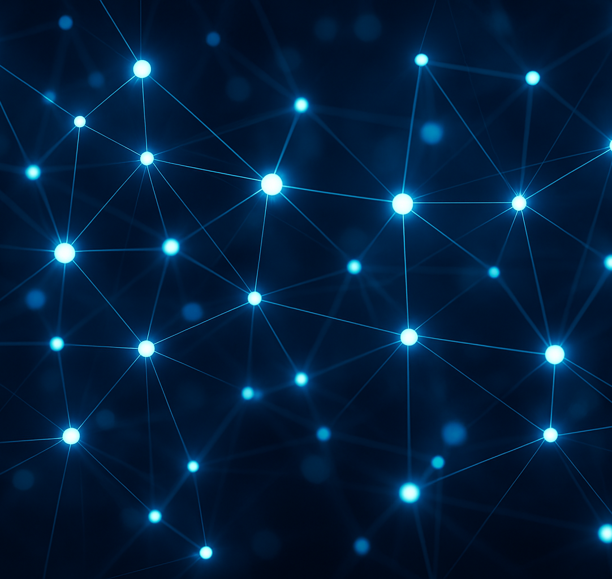
Convolutional Neural Networks
Deep Learning Layer Types
An introduction to modern CNN building blocks
20 September 2025
[1] [2]

Slide 2
Lecture outline
Recap: dense neural networks
Introduce new layer types: dropout, normalisation, activation, pooling
1D convolution: intuition and examples
2D convolution and kernels
Building deep CNNs & applications
Regularisation, extensions & outlook
[3] [4]

Slide 3
Dense networks: recap & intuition
Input
(3)
Hidden 1
(4)
Hidden 2
(2)
Output
(1)
Each neuron computes a weighted sum of all inputs, adds a bias, and applies a non‑linearity (e.g. ReLU).
Dense layers are fully connected: every input connects to every output, leading to many parameters.
Parameter count grows quickly with input dimension — motivating more efficient structures.
[5] [6]

Slide 4
Dense network forward example
Step | Operation | Output
Layer 1 linear | x·W₁ + b₁ | [-0.05, -0.05, 0.20, 0.65]
Layer 1 ReLU | max(0, h₁) | [0, 0, 0.20, 0.65]
Layer 2 linear | h₁·W₂ + b₂ | [-0.025, 0.07]
Layer 2 ReLU | max(0, h₂) | [0, 0.07]
Example input: x = [1, 0.5, -1] Weights W₁ (3×4) and W₂ (4×2) chosen for illustration. Biases are zeros for simplicity.
The computation proceeds layer by layer: linear combination followed by ReLU to produce non‑negative activations.
[7] [8]

Slide 5
New neural network layers
Dropout: randomly deactivate neurons during training to prevent over‑fitting and scale survivors to keep expectations.
Batch normalisation: normalise activations across a mini‑batch to zero mean and unit variance, then scale and shift with learnable parameters.
Activation functions: introduce non‑linearity (e.g. ReLU, sigmoid, tanh) so networks can approximate complex functions.
Pooling: downsample feature maps using max or average operations to summarise local regions and introduce invariance.
[9] [10] [11] [12]

Slide 6
Dropout
Dropout randomly sets a fraction p of activations to zero during training. Surviving activations are scaled by 1/(1−p) so that the expected value is preserved.
Example: p = 0.5 Dropout mask zeros out neurons h₂ and h₄.
Remaining activations (h₁ and h₃) are divided by (1−p) = 0.5 -> multiplied by 2.
Neuron | Original | Mask | Scaled output
h₁ | 0.50 | 1 | 1.00
h₂ | -1.00 | 0 | 0.00
h₃ | 2.00 | 1 | 4.00
h₄ | 1.00 | 0 | 0.00
[13]

Slide 7
Batch normalisation
Batch norm stabilises training by normalising activations over each mini‑batch. For each activation xᵢ: subtract batch mean μ and divide by standard deviation σ. Then scale by γ and shift by β.
Here μ = 1.25 and σ ≈ 2.28. γ = 0.5, β = 1. Each input is normalised, multiplied by γ and then β is added to produce the final output.
xᵢ | Normalized | γ·(xᵢ−μ)/σ + β
5 | 1.64 | 1.82
1 | -0.11 | 0.95
-1 | -0.99 | 0.51
0 | -0.54 | 0.73
[14]

Slide 8
Activation functions
ReLU (Rectified Linear Unit) is widely used: f(x) = max(0, x). Other activations include sigmoid and tanh, which squash inputs into (0,1) and (−1,1) respectively. Below is a ReLU curve illustrating that negative inputs are zeroed and positives pass through unchanged.
[15]

Slide 9
Pooling layers
Input
Pooling downsamples feature maps, summarising local patches and reducing spatial resolution. Two common types are max pooling (take the maximum) and average pooling (take the mean). Pooling introduces translational invariance by discarding precise positional information.
2
1
3
2
Max pooled
0
4
5
1
4
5
1
2
0
3
2
3
2
1
2
0
[16]

Slide 10
Layer types summary
Layer | # Parameters | Forward effect
Dense | m×n + m biases | Full connection, dot product & bias
Dropout | 0 (hyper‑parameter p) | Randomly zero activations & scale survivors
Batch norm | 2 per feature (γ, β) | Normalise to μ=0, σ=1 then scale/shift
Activation | 0 | Apply non‑linear function elementwise
Pooling | 0 | Downsample by reducing resolution
This table summarises the roles of each layer type, the number of learnable parameters they add, and how they transform activations during the forward pass.
[17] [18] [19] [20]

Slide 11
Why convolution?
Convolutional layers exploit local connectivity and parameter sharing. Instead of learning a weight for every input pixel, a small filter is applied across the entire input — greatly reducing the number of parameters. The bar chart compares the parameter counts of dense and convolutional layers for different input sizes.
[21] [22]

Slide 12
1D convolution: intuition
A 1D convolution slides a small filter over a 1D signal. At each position the dot product between the filter and the current window of the signal is computed, producing a new feature. This operation introduces locality and parameter sharing — the same filter is reused across positions.
Input
1
2
3
2
1
Kernel
1
0
-1
[23]

Slide 13
1D convolution example
Example: input x = [2, 0, 3, 1, −1], filter w = [1, 0, −1], stride = 1, no padding. The filter slides across the signal and computes a dot product at each position.
Position | Window | Dot product
1 | [2, 0, 3] | 2×1 + 0×0 + 3×(−1) = −1
2 | [0, 3, 1] | 0×1 + 3×0 + 1×(−1) = −1
3 | [3, 1, −1] | 3×1 + 1×0 + (−1)×(−1) = 4
Output sequence: [−1, −1, 4]
[24]

Slide 14
1D convolution: stride & padding
Stride S controls how far the filter moves each step. Padding P adds zeros to maintain output size. Output length is given by (W − F + 2P)/S + 1, where W is input length and F is filter length. Example: W = 5, F = 3, P = 1, S = 2 → (5 − 3 + 2)/2 + 1 = 3.
Padded input
0
2
0
3
1
-1
0
[25]

Slide 15
1D convolution summary
Locality: filters look at neighbouring elements instead of the entire input.
Parameter sharing: one set of weights is reused across the input, reducing parameters.
Stride & padding control the output length and allow downsampling.
The same ideas extend naturally to higher‑dimensional inputs (2D, 3D, etc.).
[26] [27]

Slide 16
2D convolution basics
Input
In 2D convolutions, a filter (kernel) slides over height and width of an input image or feature map. Each filter has dimensions H×W×D, where D equals the number of input channels. Convolution produces one feature map per filter. Multiple filters are stacked to produce multiple feature maps. The output spatial size depends on the filter size, stride and padding.
1
2
1
0
-1
0
2
1
1
Kernel
1
0
0
-1
[28]

Slide 17
2D convolution example
Input matrix A (3×3) and filter K (2×2), stride = 1, no padding. Output size = (3 − 2 + 0)/1 + 1 = 2 → a 2×2 feature map.
A
K
Output
1
2
1
1
0
2
−1
0
-1
0
0
-1
1
0
2
1
1
[29]

Slide 18
Channels & filters
Input channels
Images typically have multiple channels (e.g. RGB) — represented as a stack of 2D matrices. A convolutional filter has the same depth as the input channels, so each filter is a 3D block. Multiple filters produce multiple feature maps. Parameter count per filter = H×W×D. Weight sharing is along spatial dimensions but not across channels.
Filter
Feature map
[30]

Slide 19
2D convolution: stride & padding
Padded input (5×5)
Stride S and padding P extend naturally to 2D: the output size for each spatial dimension is (W − F + 2P)/S + 1. Zero padding can preserve the input resolution ("same" convolution) or shrink it ("valid" convolution). Example: input 5×5, filter 3×3, stride 2, P = 1 → output size = (5−3+2)/2 + 1 = 3.
[31]

Slide 20
2D pooling
Pooling extends to 2D by downsampling across patches. Typical choices are 2×2 or 3×3 windows with stride 2. No parameters are learned; pooling simply aggregates a local region. Example below shows a 4×4 input pooled to a 2×2 output using max pooling.
Input
2
3
1
4
Max pooled
1
5
2
0
5
4
0
1
3
2
4
3
4
2
1
1
[32]

Slide 21
Building a CNN
A basic CNN stacks layers in the order: convolution → activation → pooling → fully connected. Convolution and pooling reduce spatial dimensions while increasing depth. After flattening, a dense layer classifies features. The figure on the right tracks the shape of an example input (8×8) through the network.
8×8 input
Conv, ReLU & pool
Flatten
Dense→output
[33] [34]

Slide 22
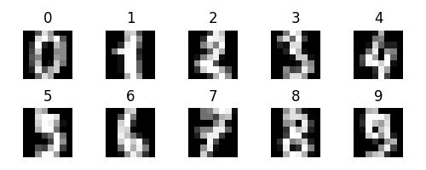
Deep CNN for digit recognition
Task: classify handwritten digits (0–9). Input images are 8×8 pixel grids. Architecture: two 3×3 conv layers with ReLU and 2×2 max pooling, followed by a flatten operation and a dense layer producing 10 logits. Below we show a montage of digits and highlight how multiple layers transform raw pixels into abstract features before classification.
[35] [36]

Slide 23
Feature hierarchies
Convolutional networks learn hierarchical features: • Early layers detect simple edges and textures. • Intermediate layers combine edges into motifs (e.g. corners, curves). • Deeper layers capture high‑level parts and objects. Illustrated on the right are abstract patterns representing different levels of abstraction.
Edges
Motifs
Objects
[37] [38]

Slide 24
Regularisation & training
Dropout: mitigates over‑fitting by randomly deactivating units.
Weight decay (L2 regularisation): penalises large weights to encourage smoother models.
Data augmentation: synthetically enlarge datasets by random cropping, flipping, scaling.
Mini‑batch training & optimisation: stochastic gradient descent (SGD) with momentum or Adam improves convergence.
Early stopping: monitor validation loss and stop training when performance no longer improves.
[39]

Slide 25
Layer and activation variations
Activation variants: Leaky ReLU allows a small gradient for negative inputs; ELU and SELU reduce vanishing gradients; Softmax maps outputs to a probability distribution for classification.
Normalisation variants: Layer norm normalises across features within one example; Group norm normalises within groups of channels; Instance norm for style transfer tasks.
Dropout variants: Spatial dropout drops entire feature maps; Shake‑Drop perturbs activations stochastically.
[40] [41]

Slide 26
Pooling variations
Average pooling: computes the mean of each patch, reducing noise.
Global average pooling: replaces the fully connected layer by averaging over the entire spatial dimension per channel.
Strided convolution: downsampling can also be achieved by using a stride > 1 instead of separate pooling layers.
Adaptive pooling: output size is specified instead of window size, automatically choosing kernel size and stride.
[42]

Slide 27
Padding strategies
Valid convolution: no padding (P = 0) → output shrinks.
Same convolution: choose P such that output has the same dimensions as the input; usually P = (F−1)/2 for odd kernels.
Full convolution: include all positions where the filter overlaps at least one input element → output is larger than the input (rarely used).
Reflect or replicate padding: pad with mirrored or repeated border values instead of zeros to reduce boundary artefacts.
[43]

Slide 28
Convolution as matrix multiplication
Convolution can be reinterpreted as a matrix multiplication by unrolling the input into patches (im2col) and flattening the filter. This representation allows us to leverage highly optimised matrix multiplication routines (e.g. BLAS) but at the cost of increased memory. Illustration: 2×2 filter applied to a 3×3 input yields a Toeplitz matrix of size 4×9 multiplied by the flattened filter vector.
im2col
[44]

Slide 29
Implementation tips
Vectorised code is critical for efficient deep learning. Use established frameworks (e.g. PyTorch, TensorFlow) that implement convolutions with GPU acceleration. Below is a simple PyTorch convolutional layer implementation:
import torch.nn as nn
class SimpleCNN(nn.Module):
def __init__(self):
super().__init__()
self.conv1 = nn.Conv2d(in_channels=1, out_channels=8, kernel_size=3)
self.pool = nn.MaxPool2d(kernel_size=2, stride=2)
self.fc1 = nn.Linear(8 * 3 * 3, 10)
def forward(self, x):
x = nn.functional.relu(self.conv1(x))
x = self.pool(x)
x = x.view(x.size(0), -1)
x = self.fc1(x)
return x
PyTorch example: 1 input channel → 8 filters → 10 classes
[45] [46]

Slide 30
Common CNN architectures
LeNet (1998): early handwritten digit recogniser; 5×5 filters, tanh activations.
AlexNet (2012): deeper nets with ReLU, dropout and 3×3 / 11×11 conv layers; won ImageNet competition.
VGG (2014): very deep (16–19 layers) using only 3×3 convs and 2×2 pooling.
ResNet (2015): introduces skip connections to ease training very deep networks (up to hundreds of layers).
Milestones of CNN development reflect increasing depth, better activations, regularisation and architectural innovations.
[47]

Slide 31
Applications of CNNs
Image classification: recognise objects in photos (e.g. cats vs. dogs).
Object detection: locate bounding boxes and labels in scenes.
Semantic segmentation: assign a class to every pixel.
Audio and speech: 1D convs process waveforms for speech recognition.
Time series & natural language: sequence models combine convs with recurrent layers or transformers.
[48] [49]

Slide 32
Advanced topics & future directions
3D convolutions: operate on volumes (e.g. video, medical imaging).
Dilated convolutions: introduce holes in kernels to expand receptive fields without increasing parameters.
Transposed convolutions: learnable upsampling for generative models and segmentation.
Self‑attention & transformers: convolution‑free alternatives that capture global context.
Neural architecture search & automated design: discover new layer combinations and topologies.
[50]

Slide 33
Summary & takeaways
Dense networks connect everything, but convolutions exploit locality and sharing to scale to high‑dimensional inputs.
Layer types such as dropout, batch norm, activations and pooling enable training deeper networks, stabilise learning and improve generalisation.
Convolution extends naturally to 2D inputs with multi‑channel filters; stride and padding control output shapes.
Building blocks combine to form deep CNNs capable of recognising complex patterns in images, speech and beyond.
Continuous innovation (activations, normalization, architectures) and regularisation are key to advancing the state of the art.
[51] [52] [53]

Slide 34
Questions?
Thank you for your attention! Feel free to ask questions or discuss your ideas on CNNs and deep learning.
Questions?
[54]

Slide 35
Further resources
Dive into Deep Learning (D2L): open textbook with interactive code examples.
CS231n: Convolutional Neural Networks for Visual Recognition – Stanford online course notes.
Deep Learning by Goodfellow, Bengio & Courville: comprehensive textbook covering theory and practice.
PyTorch and TensorFlow documentation: explore built‑in layers and tutorials for implementation.
Research papers on recent architectures (e.g. ResNet, Transformer) for cutting‑edge developments.
[55] [56]

